Slide 1

Privacy Hygiene
Small tips and tricks to make your data more your own, on a corporate internet.

Slide 2


Contents
So What’s The Problem?
Google Yourself!
Accessorize your browser
Alias
Signal!
Camera stickers!
Spring App Cleaning!

Slide 3

Cypurrsclaimer (Disclaimer)
Expiration: 06/20
Hygiene- Conditions and practices that serve to promote or preserve health.
Digital Hygiene- like brushing your teeth, but with your browsing history

Slide 4

Tip #1- So What’s The Problem?
Threat Modeling
“A way of thinking about the sorts of protection you want for your data so you can decide which potential threats you are going to take seriously.
It's impossible to protect against every kind of trick or adversary, so you should concentrate on which people might want your data, what they might want from it, and how they might get it.
Coming up with a set of possible threats you plan to protect against is called threat modeling or assessing your risks.”- EFF Surveillance Self-Defense

Slide 5
Tip #1- So What’s the Problem?
“What are you protecting?” ”Who are you protecting it from?”
“What resources do they have to take it from you?”
“What are you willing to do to protect it?”
“What vulnerabilities do you need to fill to better protect it?”
or
the Bar Test!

Slide 6

Tip #1- So What’s The Problem?
“Bar Test” Could Include:
Friends
Foes
Corporations
State Actors
Yourself!
...take the test!

Slide 7

Tip #2- Google Yourself
Notes
You can choose which criteria to search with!
check out https://myshadow.org/ for more helpful resources on understanding your digital footprint!
DuckDuckGo is great, Google may be more powerful
Things You Can Google
Name
Phone Number
Email
Social Security
Reverse Image Search

Slide 8
Tip #2- Google Yourself
Data Brokers- Companies that collect, package, and re-sell your information
Tons of profiles out there with your name, address, birthdate, places you lived, spouses, etc.
Some regulation on accuracy of info, but mostly state-by-state issue atm (see Vermont and California, maybe NY…?)
Privacyduck.com
JustDeleteMe!

Slide 9


Tip #3- Accessorize Your Browser
Extensions- add onto your browser experience by running processes in the background. These could be pop up blockers, widgets, tools and more.
Firefox and Chrome users have a bevy of options!

Slide 10
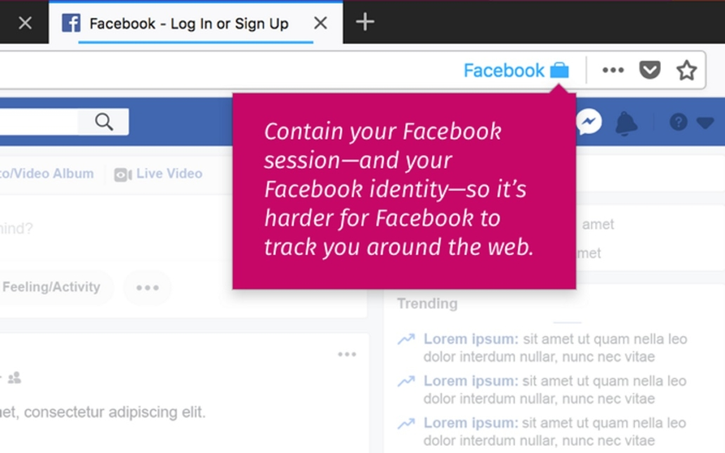

Tip #3- Accessorize Your Browser
Some more-

Slide 11
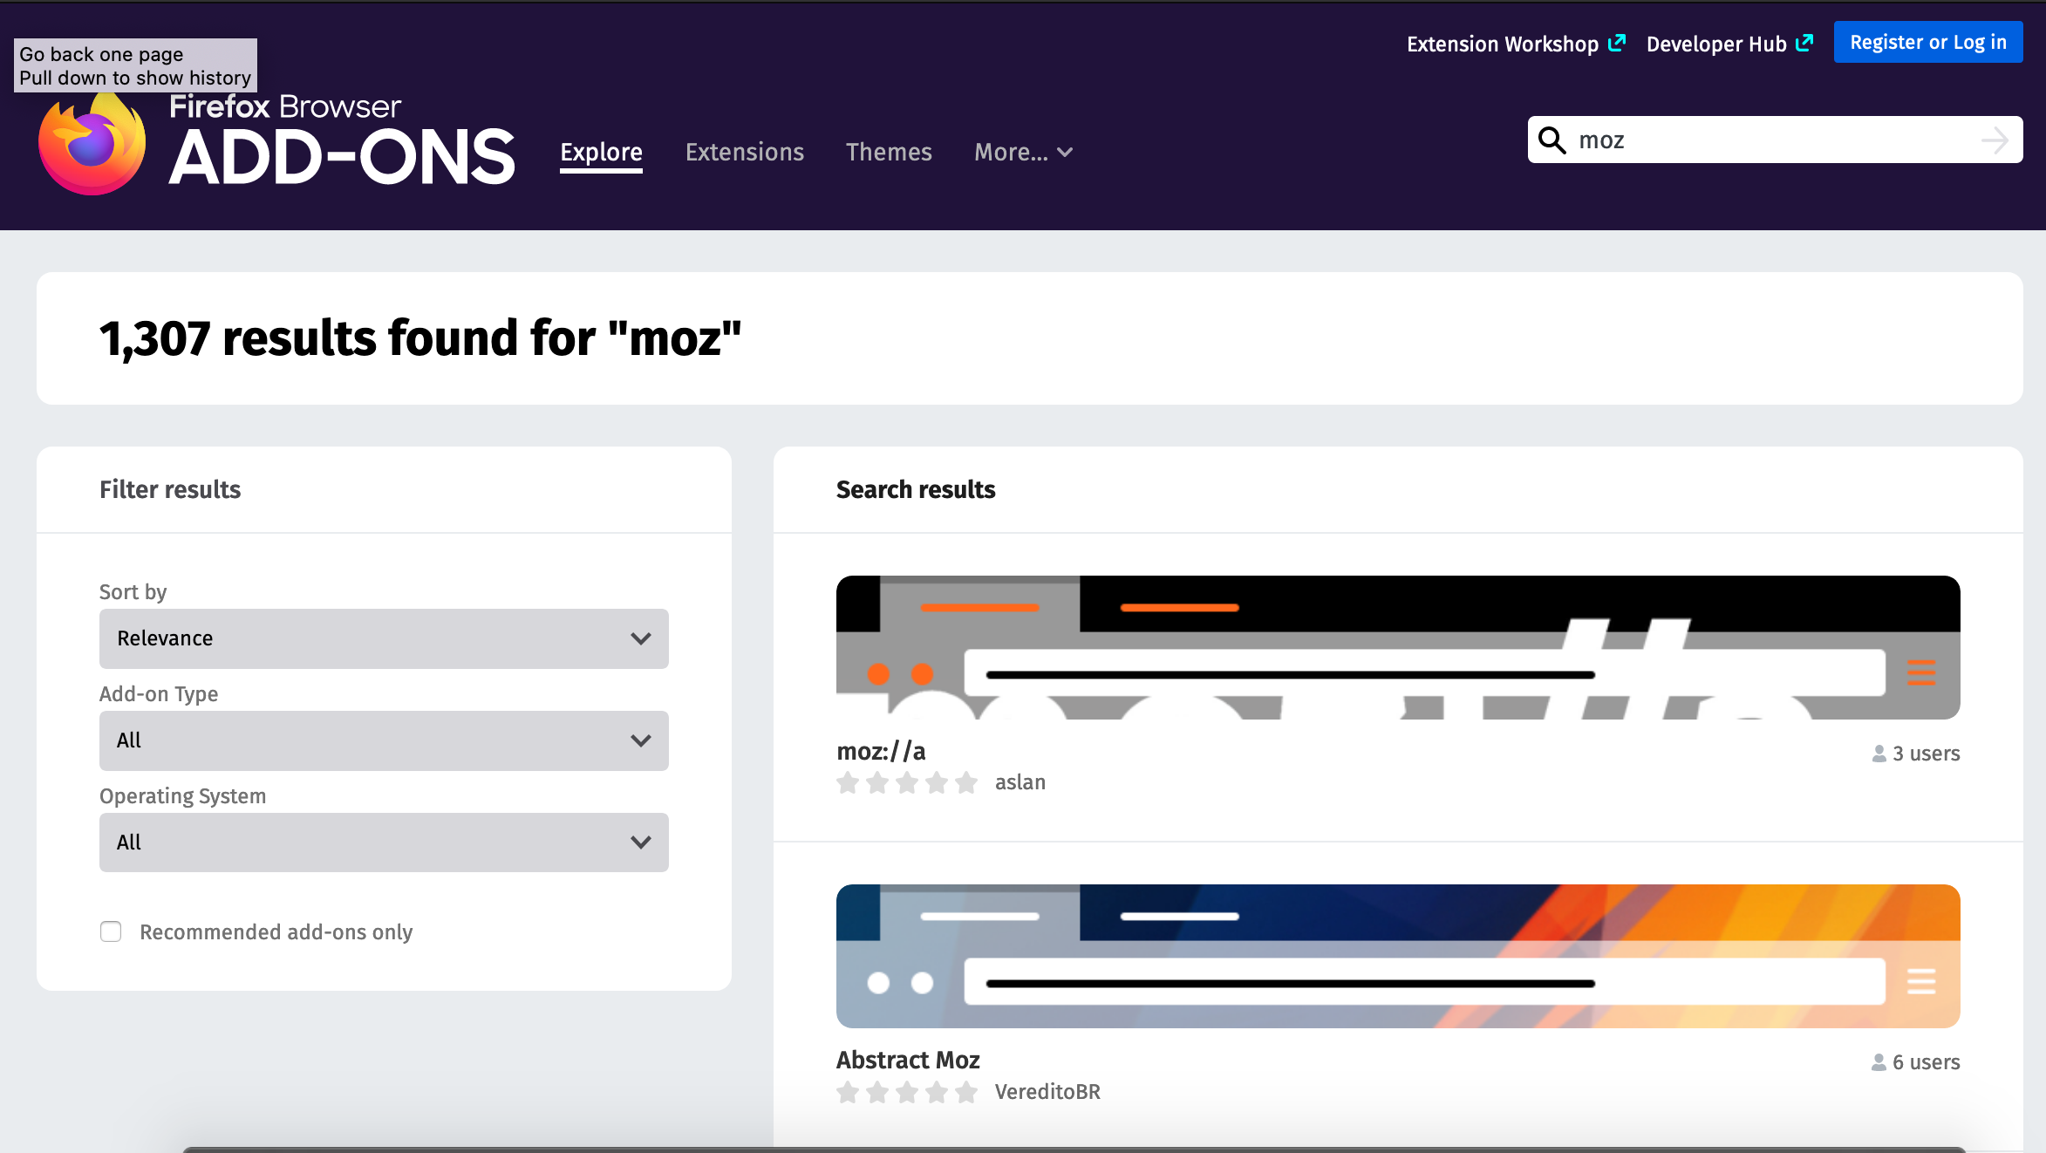
Tip #3- Accessorize Your Browser
Where do I get extensions? Usually through the “Tools” of Firefox or under “Settings” in Chrome

Slide 12
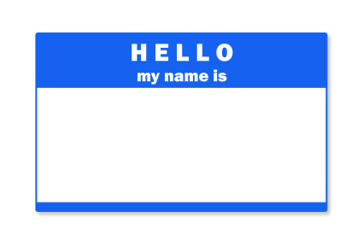
Tip #4- Alias
Some sites don’t NEED your name/email/phone number
Some sites you won’t ever come back to.
Make up a name w/ Random Name Generator!
Bonus Tip: Keep track of your identities w/ a Password Manager!

Slide 13

Tip #5- Signal
End-to-end encrypted app
Open Source, made by Open Whisper Systems
Great way to send pics/docs to folks; when you don’t want to send through Messenger
Available for Apple and Android Phones
Note: only encrypted when sending to
other Signal users

Slide 14

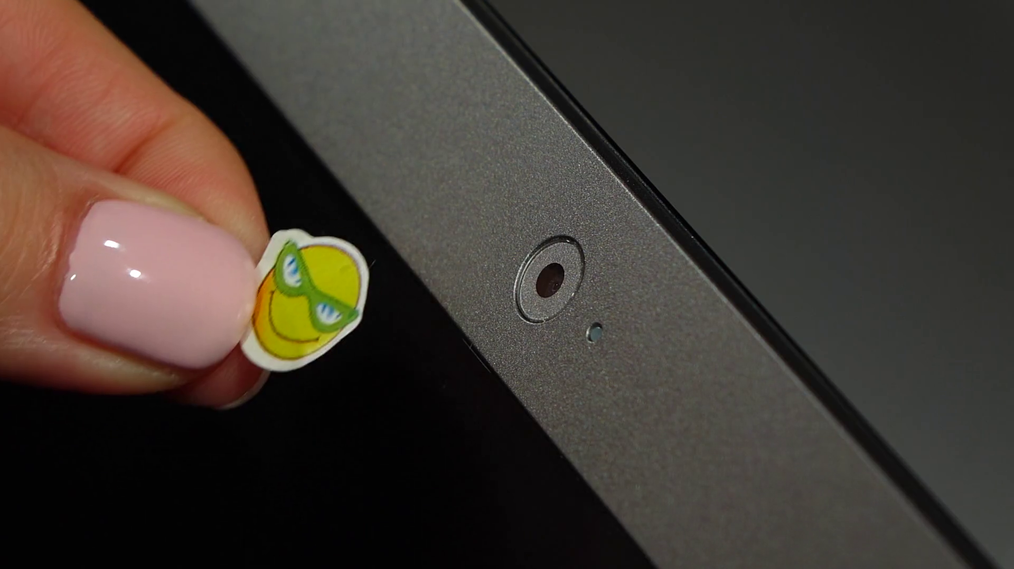
Tip #6- Camera Stickers

Slide 15

Tip #7- Spring App Cleaning
What apps do I use a lot?
What apps don’t I use at all?
Do I need to have them on my phone?
For the apps I keep, what permissions have I given them for my phone?

Slide 16

Review
So What’s The Problem?
Google Yourself!
Accessorize your browser
Alias
Signal!
Camera stickers!
Spring App Cleaning!

Slide 17
Other Resources
For more privacy and cybersecurity fun, check out:
EFF Surveilance Self-Defense
MyShadow.org
Data Detox Kit

